Slide 1



CAPSTONE PROJECT · PHASE A
RightRent
AI Lease Review for Tenants
An AI-based web application for analyzing residential rental contracts, anchored in the Israeli Fair Rental Law.
Code: 26-2-D-6
Ashraf Atshy · Kian Gadban
Advisor: Mr. Eyal Sade
GitHub Repository

Slide 2



WHY THIS PROJECT
Why Rental Contract Review Matters
Renting Is Now Long-Term
Privately-Owned Apartments
Renting is becoming a long-term housing arrangement in Israel, not a short stopover.
Most rental apartments are owned by private individuals, not managed companies.
Landlord-Drafted Contracts
Information Asymmetry
Rental contracts are usually drafted by the landlord, on the landlord's terms.
Tenants face information asymmetry before signing, with far less legal knowledge than the other side.
02

Slide 3




THE PROBLEM
A Tenant's Three Bad Options
SLOW
COSTLY
RISKY
Review It Alone
Hire a Lawyer
Sign Blindly
Requires legal knowledge most tenants simply do not have.
Effective, but expensive and time-consuming for a single lease.
Exposes the tenant to legal and financial risk with no review at all.
Tenants need fast, affordable, situation-specific contract review.
03

Slide 4


CURRENT GAP
No B2C Tool for Tenants
Legal-Tech Tools
Rental Platforms
Tenant-Side Tools
Serve lawyers & companies
Serve landlords
The gap: nothing checks a lease for the tenant
There is no B2C tool for tenants that checks rental contracts against Israeli law.
RightRent fills this tenant-side protection gap.
04

Slide 5


OUR SOLUTION & CONTRIBUTION
What RightRent Adds
TODAY
WHAT WE ADD
Tenant reads the lease alone.
RAG-based analysis grounded in the Israeli Fair Rental Law.
Red / orange visual highlighting on the PDF.
No legal highlighting inside the PDF.
Missing-protection detection.
No personalization to tenant preferences.
Personalized risk analysis based on tenant preferences.
No structured negotiation support.
Negotiation agent that drafts one editable WhatsApp message.
05

Slide 6










REQUIREMENTS
System Requirements
FUNCTIONAL REQUIREMENTS
NON-FUNCTIONAL REQUIREMENTS
Account & Access
Performance
Register, log in, manage and edit preferences.
1-6 page contract analyzed in under 90 seconds; 10 concurrent users.
Contract Intake
Security
Upload a rental PDF, validate it, and OCR scanned documents.
bcrypt password hashing, HTTPS only, with XSS and CSRF protection.
AI Analysis
Privacy
Confirm preferences, extract text and coordinates, anonymize PII, retrieve law, classify risk, and detect missing protections.
Names, ID numbers and addresses are anonymized before LLM calls; history can be deleted.
Results & History
Availability
View findings, marked PDF, dashboard, history, and delete saved analyses.
99% uptime target during deployment.
Negotiation
Compatibility
Run the negotiation agent, review and edit the WhatsApp draft, then send manually.
Modern browsers and mobile devices, via responsive design.
Internal
Law Sync
Legal Currency
System updates the Fair Rental Law knowledge base automatically through an external API.
Legal knowledge base updates without retraining the model.
06

Slide 7
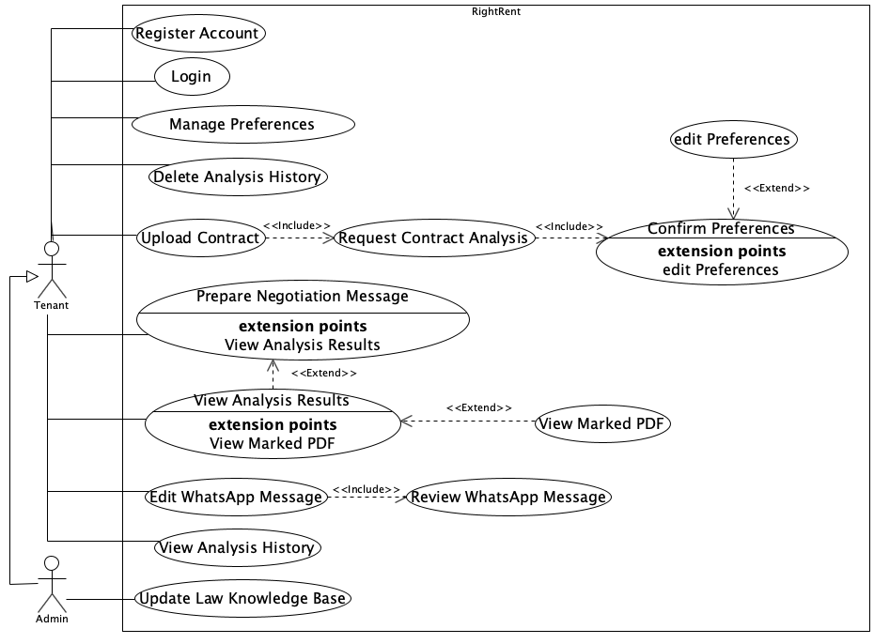
USE CASE
Use Case Diagram
07

Slide 8
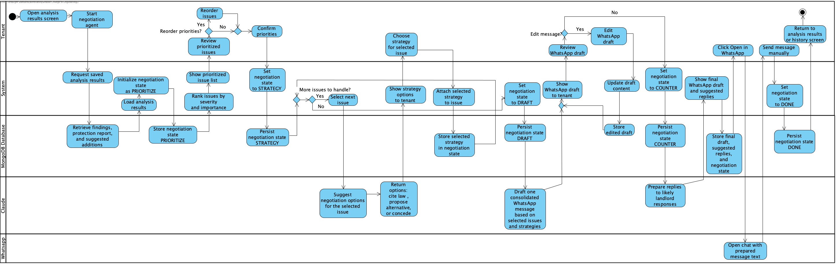
Activity Diagram
Negotiation Agent and WhatsApp Message Preparation

Slide 9
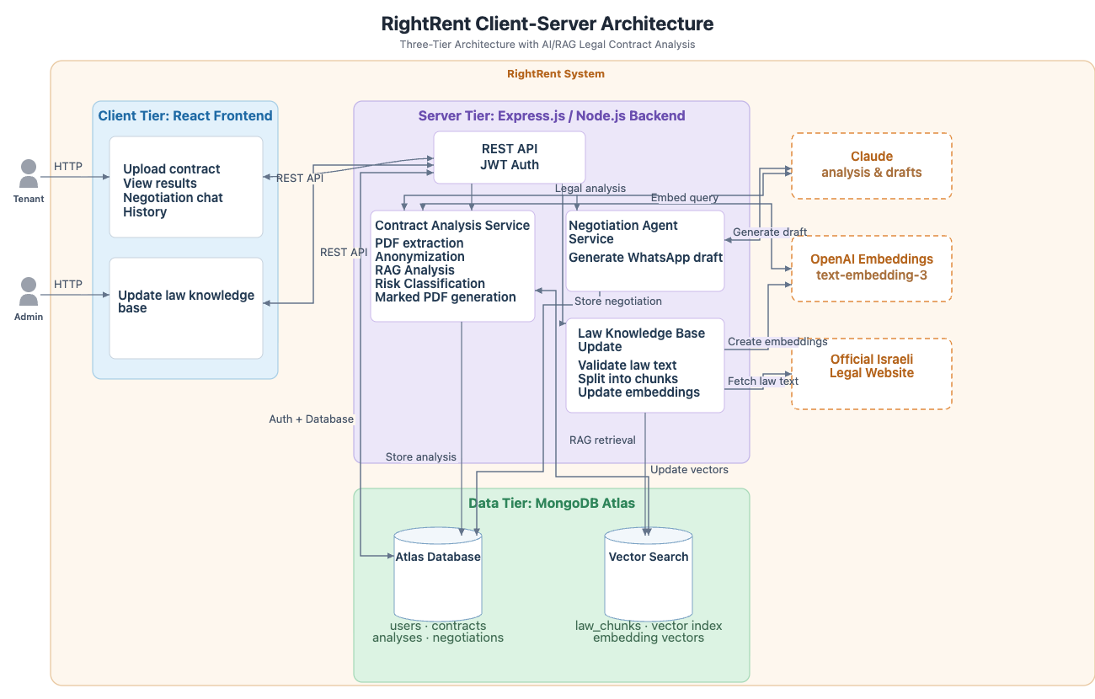
ARCHITECTURE
System Architecture
08

Slide 10
RAG PIPELINE
How the Analysis Works
1
2
3
4
Law Knowledge Sync
Contract Intake
Retrieval & Analysis
Results
Fetch updated Fair Rental Law text from a configured legal source API
Tenant uploads a rental PDF up to 10 MB
Convert each clause to an embedding
Run contract-level checklist for missing or partial protections
Parse sections, normalize text, validate extraction
Extract text and word coordinates with pdfjs-dist
Retrieve top-k = 5 relevant law chunks
Generate marked PDF, dashboard, and suggested additions
Embed law chunks and store them in MongoDB Vector Search
Run Tesseract.js OCR if the PDF is scanned
Claude checks legality and preference conflicts
Redact PII using regex + Hebrew NER
Rule layer assigns RED / ORANGE / OK
Split into clause-sized chunks of about 200-300 words
09

Slide 11
SYSTEM PERFORMANCE GOALS
Concrete, Testable Targets
< 90 sec
top-k = 5
RED / ORANGE / OK
Analyze a 1-6 page contract
Relevant law chunks retrieved
Deterministic final classification
Privacy-First
anonymize before LLM calls
10

Slide 12
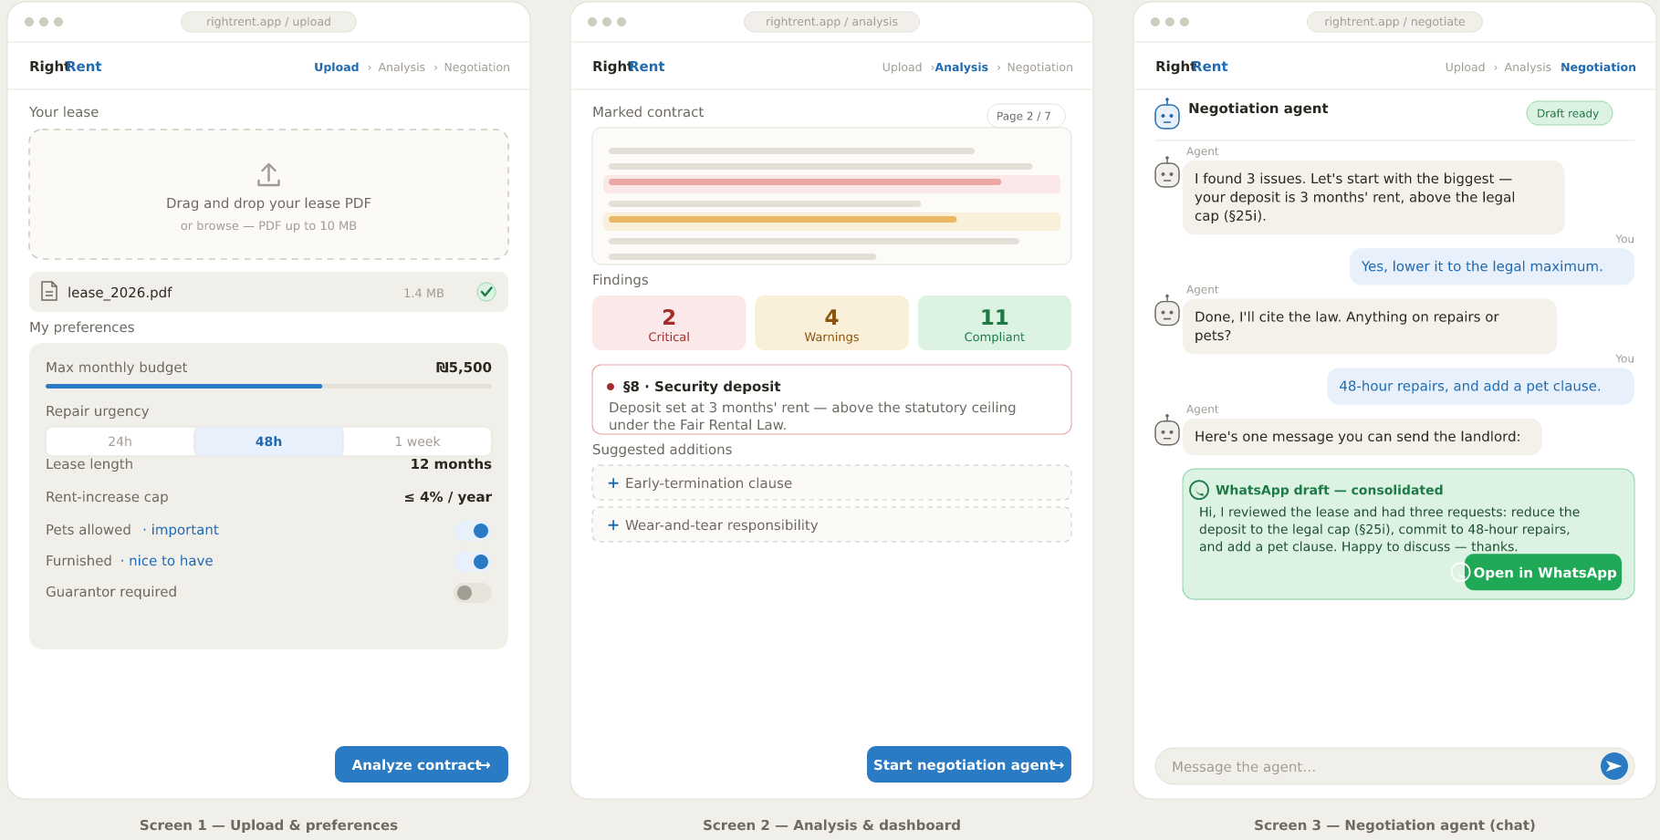
USER INTERFACE
From Upload to Negotiation
11

Slide 13


IMPLEMENTATION CHALLENGES & PHASE B PLAN
Expected Challenges & Next Steps
EXPECTED CHALLENGES
PHASE B NEXT STEPS
PDF structure and scanned documents.
1
Build React upload and preferences screens.
6
Implement RAG pipeline with Claude.
Privacy before cloud LLM calls.
Implement PDF extraction
Generate marked PDF and dashboard.
2
7
Keeping the law knowledge base updated.
3
Add OCR support with Tesseract.js.
8
Build negotiation agent and WhatsApp draft flow.
4
Build anonymization layer.
9
Test real rental contracts against expected expert-reviewed results, measuring accuracy, response time, and usability.
5
Create law embeddings in MongoDB Vector Search.
12

Slide 14
Thank You
Any Questions?
RightRent
Code: 26-2-D-6
Ashraf Atshy · Kian Gadban
Advisor: Mr. Eyal Sade
Braude College of Engineering

